Slide 1
SQL Exercises
Chapter 7

Slide 2
1. making changes to a PRODUCT table

Slide 3
1. making changes to a PRODUCT table
UPDATE PRODUCT
SET P_INDATE = ‘18-JAN-2004’
WHERE P_CODE = ‘13-Q2/P2’;

Slide 4
delete the table row where
the P_CODE is ‘BRT-345’.

Slide 5
delete the table row where
the P_CODE is ‘BRT-345’.
DELETE FROM PRODUCT
WHERE P_CODE = ‘BRT-345’;

Slide 6
output the table contents when
the value of V_CODE is equal to 21344?

Slide 7
3. output the table contents when
the value of V_CODE is equal to 21344?
SELECT P_DESCRIPT, P_INDATE, P_PRICE,
V_CODE
FROM PRODUCT
WHERE V_CODE = 21344;

Slide 8
4. output the table contents when
the value of V_CODE is NOT equal to 21344?

Slide 9
4. output the table contents when
the value of V_CODE is NOT equal to 21344?
SELECT P_DESCRIPT, P_INDATE, P_PRICE,
V_CODE
FROM PRODUCT
WHERE V_CODE <> 21344;

Slide 10
5. output the table contents when the value of
the character field P_CODE
is alphabetically less than 1558-QW1?

Slide 11
5. output the table contents when the value of
the character field P_CODE
is alphabetically less than 1558-QW1?
SELECT P_CODE, P_DESCRIPT, P_QOH, P_MIN,
P_PRICE
FROM PRODUCT
WHERE P_CODE <‘1558-QW1’;

Slide 12
6. list all the rows in which the inventory
stock dates occur on or after January 20, 2016?

Slide 13
6. list all the rows in which the inventory
stock dates occur on or after January 20, 2016?
SELECT P_DESCRIPT, P_QOH, P_MIN, P_PRICE,
P_INDATE
FROM PRODUCT
WHERE P_INDATE >= ‘20-JAN-2016’;

Slide 14
7. determine the total value of inventory held
on hand

Slide 15
7. determine the total value of inventory held
on hand
SELECT SUM(P_QOH*P_PRICE)
FROM PRODUCT;

Slide 16
List the table contents for either
V_CODE = 21344 or V_CODE = 24288?

Slide 17
List the table contents for either
V_CODE = 21344 or V_CODE = 24288?
SELECT P_DESCRIPT, P_INDATE, P_PRICE, V_CODE
FROM PRODUCT
WHERE V_CODE = 21344 OR V_CODE = 24288;

Slide 18
9. The query to join the P_DESCRIPT and P_PRICE
fields from the PRODUCT table and the
V_NAME, V_AREACODE, V_PHONE,
and V_CONTACT fields from the VENDOR
table where the values of V_CODE.

Slide 19
9. The query to join the P_DESCRIPT and P_PRICE
fields from the PRODUCT table and the
V_NAME, V_AREACODE, V_PHONE,
and V_CONTACT fields from the VENDOR
table where the values of V_CODE.
SELECT P_DESCRIPT, P_PRICE, V_NAME,
V_CONTACT, V_AREACODE, V_PHONE
FROM PRODUCT, VENDOR
WHERE PRODUCT.V_CODE = VENDOR.V_CODE;

Slide 20
10. The query to join the P_DESCRIPT and P_PRICE
fields from the PRODUCT table and the V_NAME,
V_AREACODE, V_PHONE and V_CONTACT fields from
the VENDOR table, where the values of V_CODE
match and the output is ordered by the price.

Slide 21
10. The query to join the P_DESCRIPT and P_PRICE
fields from the PRODUCT table and the V_NAME,
V_AREACODE, V_PHONE and V_CONTACT fields from
the VENDOR table, where the values of V_CODE
match and the output is ordered by the price.
SELECT PRODUCT.P_DESCRIPT, PRODUCT.P_PRICE,
VENDOR.V_NAME, VENDOR.V_CONTACT,
VENDOR.V_AREACODE, VENDOR.V_PHONE
FROM PRODUCT, VENDOR
WHERE PRODUCT.V_CODE = VENDOR.V_CODE
ORDER BY PRODUCT.P_PRICE;

Slide 22
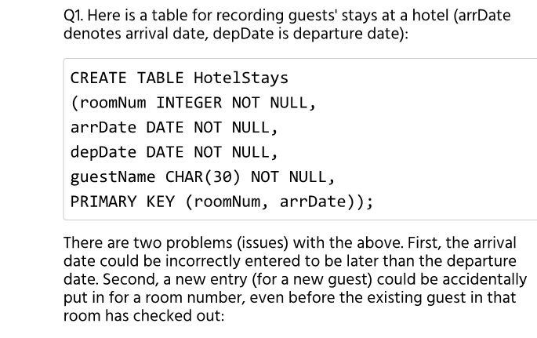
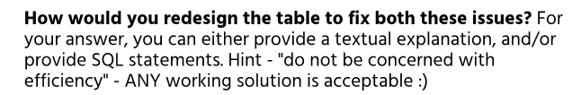

Slide 23
RoomNumber Date GuestName
-----------------
CREATE TABLE HotelStays
(roomNum INTEGER NOT NULL,
date DATE NOT NULL,
guestName CHAR(30) NOT NULL,
PRIMARY KEY (roomNum, date));
In other words, create a distinct row for each day a guest stays in a room! That will avoid duplicates (overlaps), and get rid of the problem of end<start.

Slide 24
CREATE OR REPLACE FUNCTION date_validator() RETURNS TRIGGER AS $exe$
BEGIN
IF NEW.arrDate > NEW.depDate Then
delete from HotelStays where (roomNum = NEW.roomNum AND arrDate = NEW.arrDate);
ELSEIF EXISTS(select arrDate, depDate from HotelStays where ((NEW.arrDate >arrDate AND NEW.arrDate<depDate)OR (NEW.depDate >arrDate AND NEW.depDate<depDate)OR (NEW.depDate >depDate AND NEW.arrDate<arrDate))) Then
delete from HotelStays where (roomNum = NEW.roomNum AND arrDate = NEW.arrDate);
END IF;
RETURN NEW;
END;
$exe$
Language plpgsql;
create trigger date_valid
AFTER INSERT ON HotelStays
FOR EACH ROW EXECUTE PROCEDURE date_validator();
INSERT INTO HotelStays VALUES (123, to_date('20160202', 'YYYYMMDD'), to_date('20160206','YYYYMMDD'), 'A');
INSERT INTO HotelStays VALUES (123, to_date('20160204', 'YYYYMMDD'), to_date('20160208','YYYYMMDD'), 'B');
INSERT INTO HotelStays VALUES (201, to_date('20160210', 'YYYYMMDD'), to_date('20160206','YYYYMMDD'), 'C');

Slide 25
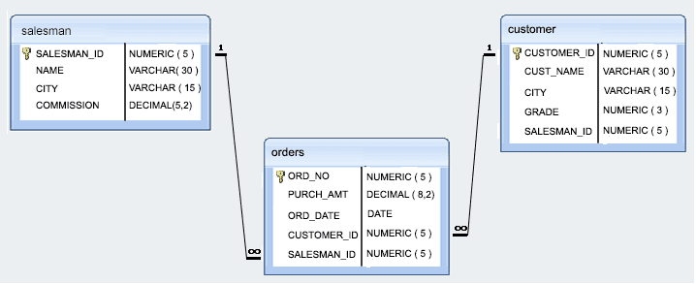
http://www.w3resource.com/sql-exercises/sql-retrieve-from-table.php
Schema for Exercises 6-11

